Slide 1

Implementing ExecutorService
Needs to build a Java application, in which several concurrent tasks need to be performed.
To accomplish this task, you need to create and manage several threads.
A developer

Slide 2
Implementing ExecutorService (Contd.)
For the preceding purpose, you can use executors. An executor is a mechanism to execute tasks.

Slide 3

Implementing ExecutorService (Contd.)
  The java.util.concurrent package provides the executors feature.
  The executors can be used effectively to manage the thread tasks.
  By using executors, the creation and management of threads can be separated from the rest of the application.
  Some of the following executor interfaces are:
    Executor
    ExecutorService
  The Executor interface is used to execute tasks by using an executor.
  A task is an object that implements the Runnable or Callable interface.

Slide 4
Implementing ExecutorService (Contd.)
  The Executor interface provides the execute() method that executes the Runnable tasks.
  The signature of the execute() method is:
  public void execute(Runnable task)
  Some of the limitations of using the Executor interface are:
    An executor cannot be used to execute a collection of runnable tasks.
    The executor executes runnable tasks and a runnable task cannot return a value to its calling method.
    An executor cannot be used for actions, such as cancel the execution of runnable tasks.
    You cannot shutdown an executor.

Slide 5
Implementing ExecutorService (Contd.)
  An ExecutorService extends the Executor interface.
  ExecutorService:
    Can be used with a large pool of threads to execute runnable or callable tasks.
    Provides the additional methods for managing the tasks of an executor.
  Some of the methods of the ExecutorService interface are:
    boolean isShutdown()
    void shutdown()
    boolean isTerminated()
    List<Runnable> shutdownNow()
    Future<?> submit(Runnable task)
    Future<?> submit(Callable<T> task)

Slide 6
Implementing ExecutorService (Contd.)
  You can also create a cached thread pool. This method has the following signature:
    public static ExecutorService newCachedThreadPool()
  A cached thread pool allows:
    The creation of new threads as and when they are required.
    The reuse of threads as the threads used in the pool can be reused after they finish their tasks.
    The termination of threads that have been idle for a period of 60 seconds.
  You can use the following code snippet to create a new cached thread pool executor service:
    ExecutorService threadpool = Executors.newCachedThreadPool();

Slide 7
Implementing ExecutorService (Contd.)
  Consider the code given in the embedded document that shows how to work with the executor service and execute Runnable tasks:
  Consider the code given in the embedded document that shows how to work with the executor service and execute Callable tasks:

Slide 8
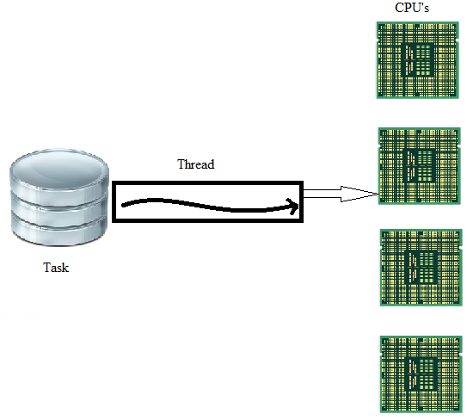
Implementing Fork/Join Framework
  The following figure shows how the computing power can be wasted when an application is not utilizing all the available processors for executing its tasks.

Slide 9
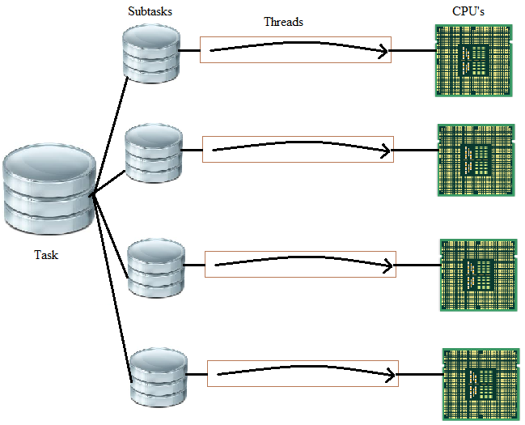
Implementing Fork/Join Framework (Contd.)
  The following figure shows how the effective CPU utilization can be achieved by using the fork/join framework.

Slide 10
Implementing Fork/Join Framework (Contd.)
  The classes that can be used for implementing the fork/join framework are:
    ForkJoinPool
    ForkJoinTask
    RecursiveTask
    RecursiveAction
  Consider the code given in the embedded document that can be used to implement the fork/join programming to find the maximum value from an array of integers:

Slide 11
Just a minute
  The ______ class is the super class of all the tasks that will be executed in ForkJoinPool.

Slide 12
Just a minute (Contd.)
  Solution:
    ForkJoinTask

